Slide 1

Newton Raphson Method
Prianka Mandal
Lecturer
Daffodil International University

Slide 2
Introduction
Methods such as the bisection method and the false position method of finding roots of a nonlinear equation require bracketing of the root by two guesses.
Such methods are called bracketing methods
These methods are always convergent since they are based on reducing the interval between the two guesses

Slide 3
Introduction (Cont.)
In the Newton-Raphson’s method, the root is not bracketed.
In fact, only one initial guess of the root is needed to start the iterative process and to find the root of an equation
The method hence falls in the category of open methods
Convergence in open methods is not guaranteed but if the method does converge, it does faster than the bracketing methods

Slide 4
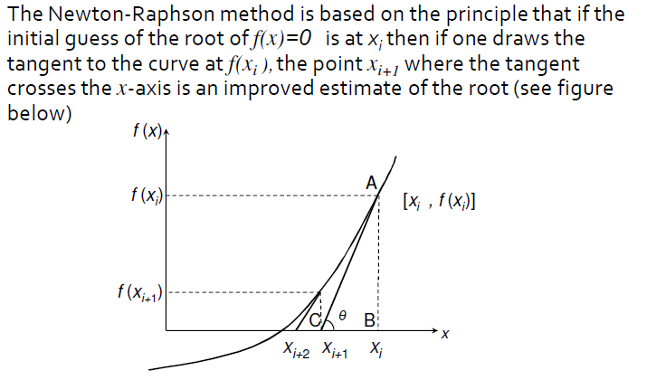
Derivation of Newton-Raphson Method

Slide 5
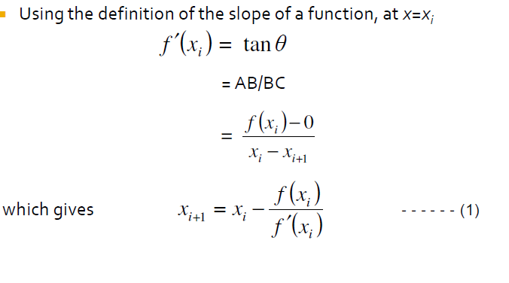
Derivation of Newton-Raphson Method (Continued)

Slide 6
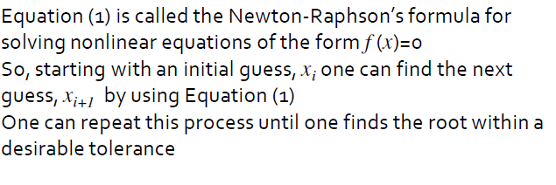
Newton-Raphson Method
....
....
.........

Slide 7


Steps of Newton-Raphson Method
Step1: Evaluate f′(x) symbolically.
Step2: Use Initial guess of the root, x_{i} to estimate the new value of the root, x_{i+1} as
Step3: Find the absolute relative approximate error |ɛ_{a}| as

Slide 8
Steps of Newton-Raphson Method (Continued)
Steps4: Compare the absolute relative approximate error with the pre- specified relative error tolerance.
If |ɛ_{a}|> ɛ_{s} then go to step2 else stop the process.
Step6: Set x_{i+1} as new x_{i} and again calculate new x_{i+1}
Also check is number of the iteration has exceeded the maximum umber of iteration.

Slide 9
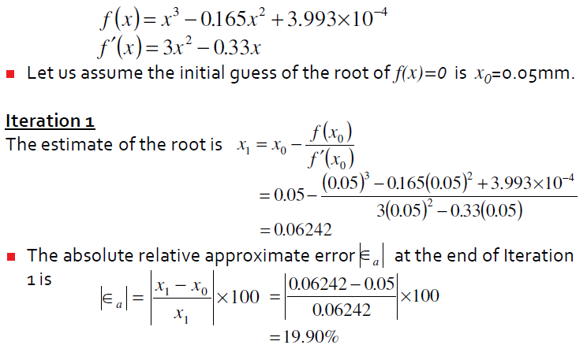
Example

Slide 10
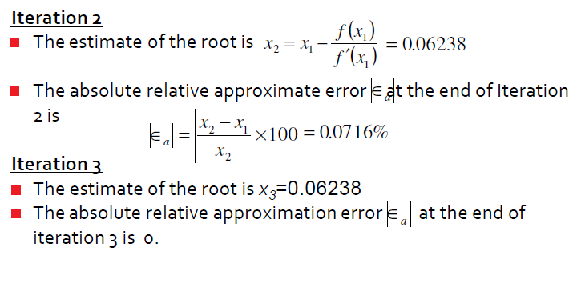
Example (Continued)

Slide 11

Drawbacks of Newton-Raphson method
For a formula like above, if anyway f′(x_{i}) is zero then the result will be infinity. Which is not acceptable.
To solve this problem, we can use Secant Meathod.

Slide 12
Exercise
Use the Newton-Raphson method to estimate the root of f(x) = e^{-x} - x, employing an initial guess of x₀ = 0. Find є_{t} for each iteration until є_{t} < 0.1.
Determine the positive root of f(x) = x ¹⁰ - 1 using the Newton Raphson method and an initial guess of x = 0.5. Show first five iterations.

Slide 13
Thank you!!!

